Slide 1
Service Fabric Patterns & Best Practices

Slide 2
Service Fabric + IoT Hub
Vaclav Turecek

Slide 3
Application types and instances
Named application instances can be created at any time
Create
Package
Copy
Register
Upgrade
Build and deployment time
Delete
Runtime

Slide 4
Application types and instances
Named application instances can be created at any time
MyAppType 2.0
fabric:/myapp
fabric:/anotherapp
ServiceType A
1.2
fabric:/myapp/serviceA
fabric:/myapp/serviceA
Create
ServiceType B
1.5
fabric:/myapp/serviceB
fabric:/myapp/serviceB

Slide 5
Multi-tenant applications
A named application instance is created for each tenant.
TenantAppType 2.0
fabric:/UserA
fabric:/UserB
WebServiceType
1.2
fabric:/UserA/Web
fabric:/UserB/Web
Create
DataServiceType
1.5
fabric:/UserA/Data
fabric:/UserB/Data

Slide 6
Typical IoT data flow

Slide 7
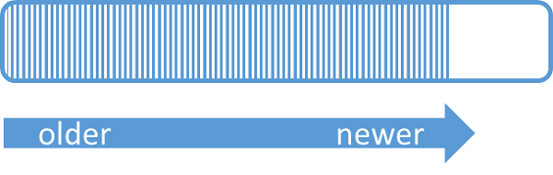
IoT Hub and Event Hub partitioning
A partition in IoT Hub and Event Hub is an ordered sequence of events.
Similar to a commit log.

Slide 8
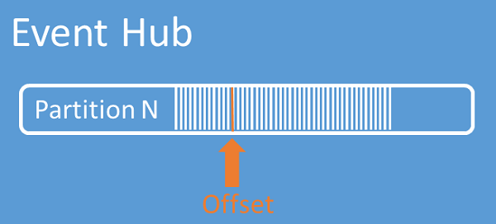
IoT Hub and Event Hub partitioning
An offset is a position in the event stream of a partition.
Consumers must keep track of the offset outside of IoT Hub and Event Hub.

Slide 9
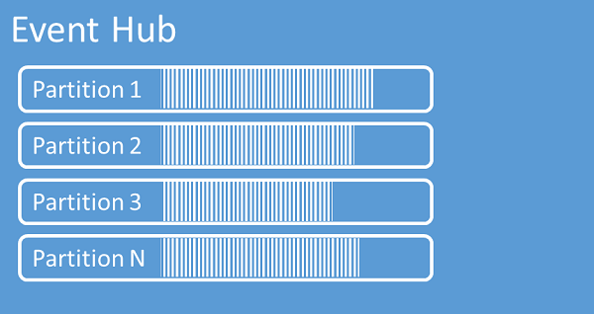
IoT Hub and Event Hub partitioning
Multiple independent partitions contain their own sequence of event data.
Partitions are distributed across machines for scale.
Consumers must coordinate with each other to read from multiple partitions.

Slide 10
IoT Hub and Event Hub partitioning
EventProcessorHost: Consuming events with stateless workers
Worker Role 1
IoT Hub
Worker Role 1
IoT Hub
EventProcessorHost
EventProcessorHost
Consumer 1
Partition 1
Consumer 1
Partition 1
Consumer 2
Partition 2
Consumer 2
Partition 2
Consumer 3
Partition 3
Consumer 3
Partition 3
Worker Role 2
Partition 4
Consumer 4
Partition 4
EventProcessorHost
Partition 5
Consumer 5
Partition 5
Consumer 3
Partition 6
Consumer 6
Partition 6
Consumer 4
Consumer 5
Azure Storage
Azure Storage

Slide 11
IoT Hub and Event Hub partitioning
EventHubReceiver: Consuming events with a stateful service
Node 1
IoT Hub
Node 1
IoT Hub
Stateful Service
Stateful Service
Partition 1
Partition 1
Partition 1
Partition 1
Partition 2
Partition 2
Partition 2
Partition 2
Partition 3
Partition 3
Partition 3
Partition 3
Node 2
Partition 4
Partition 4
Partition 4
Stateful Service
Partition 5
Partition 5
Partition 5
Partition 3
Partition 6
Partition 6
Partition 6
Partition 4
Partition 5

Slide 12
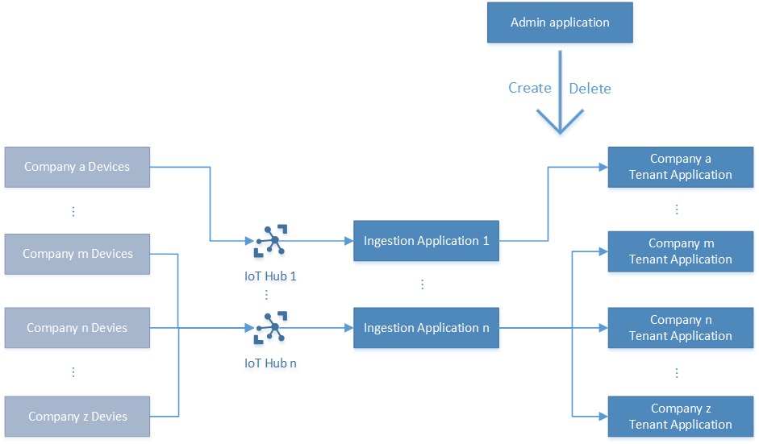
Multi-tenant IoT application

Slide 13
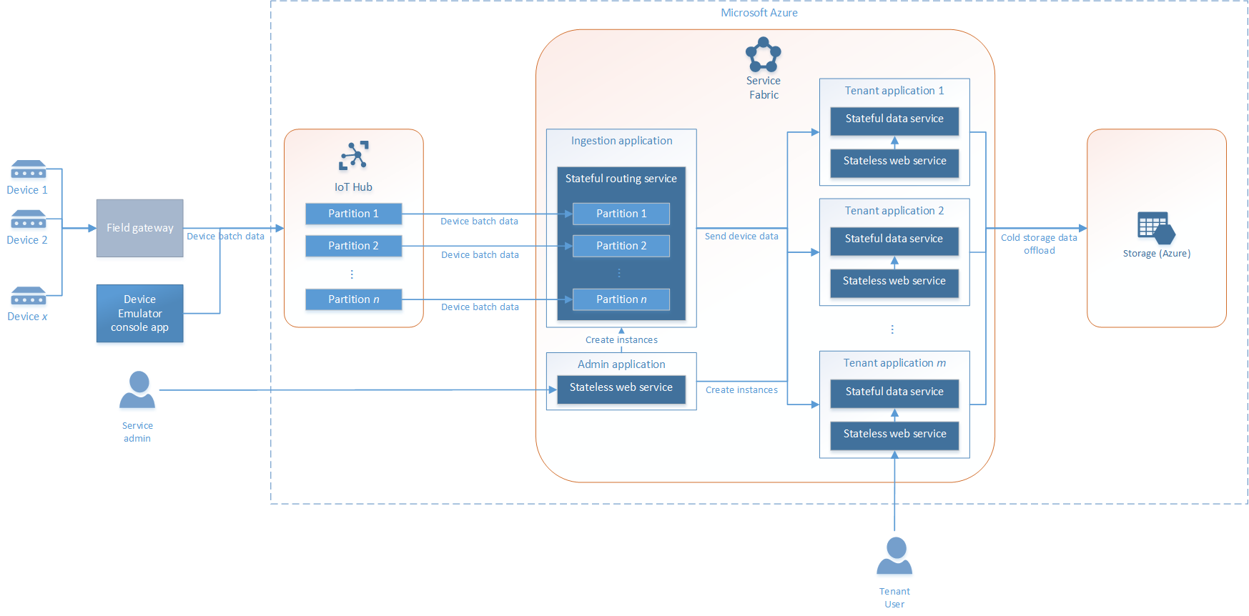
Multi-tenant IoT application

Slide 14
Multi-tenant IoT application
https://github.com/Azure-Samples/service-fabric-dotnet-iot

